Slide 1





React & Firebase
#3 Firebase Auth with Various Providers

Slide 2

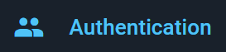
Firebase Authentication provides backend services, easy-to-use SDKs, and ready-made UI libraries to authenticate users to your app. It supports authentication using passwords, phone numbers, popular federated identity providers like Google, Facebook and Twitter, and more.
Firebase Authentication integrates tightly with other Firebase services, and it leverages industry standards like OAuth 2.0 and OpenID Connect, so it can be easily integrated with your custom backend.

Slide 3



How to Setup React and
Firebase Authentication
with Google Provider?

Slide 4
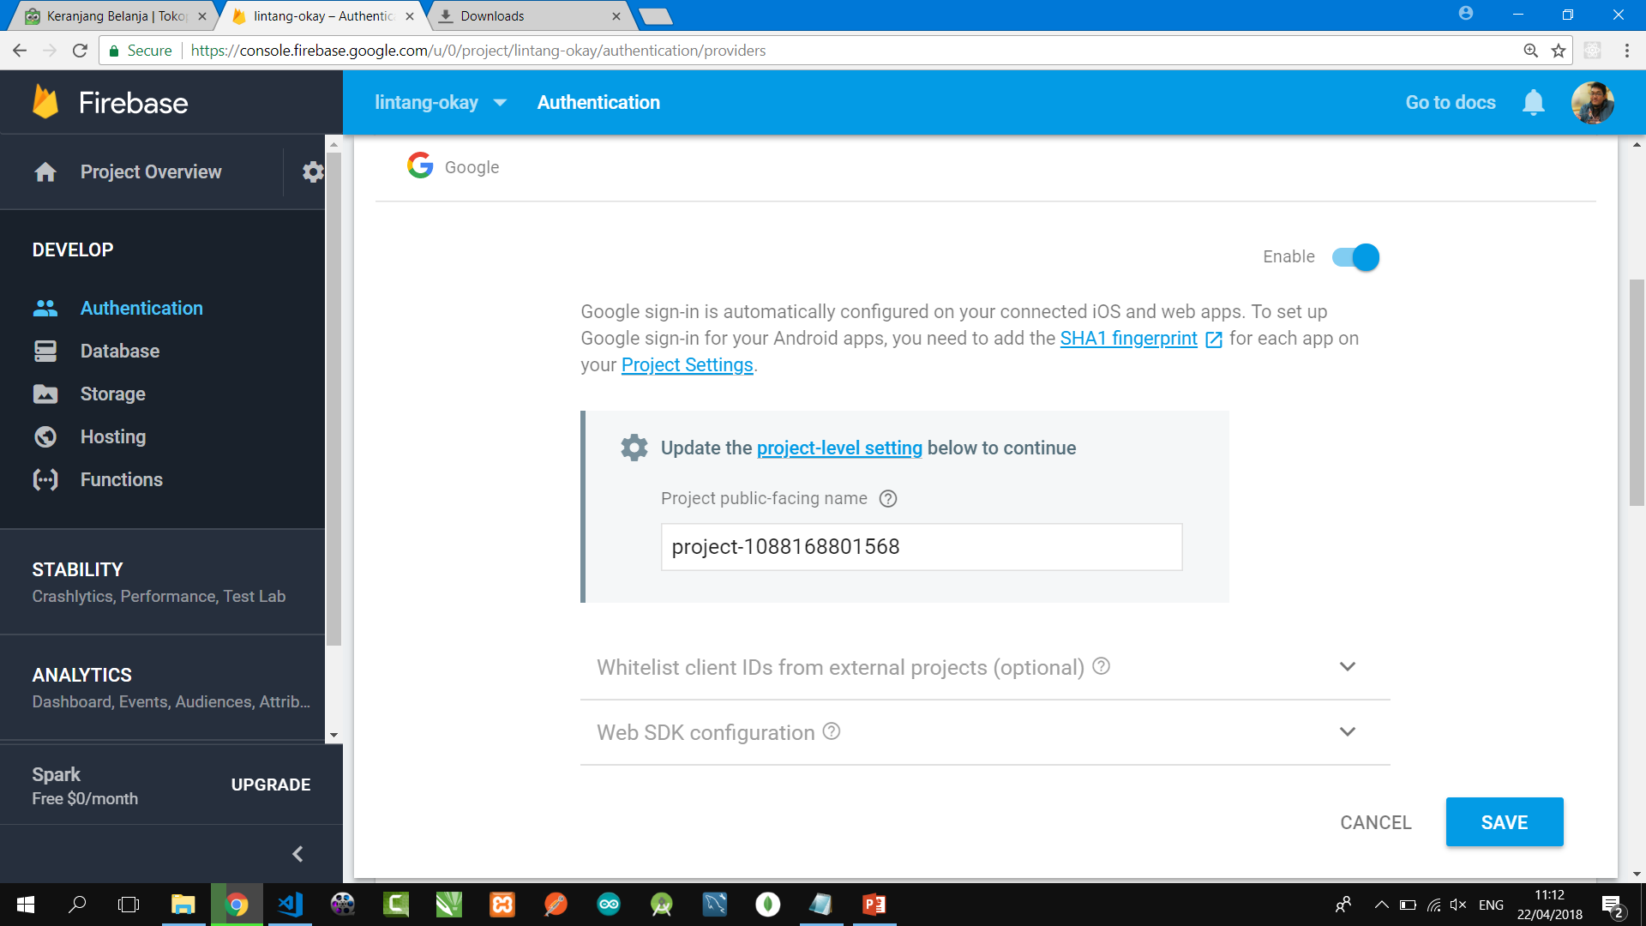
#1 Setup Firebase Auth
Login to Firebase Console, choose/create a project then go to Firebase Authentication. On Sign-In Method tab, enable Google sign-in provider then Save it!

Slide 5
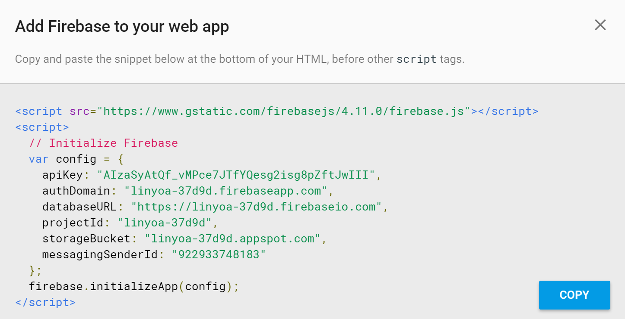
#2 Firebase Snippet
Go to Project Overview, choose Add Firebase to Your Web App then copy its snippet code.

Slide 6
#3 Create/Prepare Your React App
Install create-react-app utility globally on your PC (if you have not done yet before)
$ npm install -g create-react-app
Create a new react app or prepare yours
$ create-react-app lin_auth
$ cd lin_auth
Install Firebase packages needed
$ npm install -g firebase-tools
$ npm install firebase

Slide 7
src/fire.js
#4 Insert Snippet
Create src/fire.js
import firebase from 'firebase';
var config = {
apiKey: "a1b2c3d4e5f6g7h8i9j0",
authDomain: "lintang-auth.firebaseapp.com",
databaseURL: "https://lintang-auth.firebaseio.com",
projectId: "lintang-auth",
storageBucket: "lintang-auth.appspot.com",
messagingSenderId: "1234567890"
};
firebase.initializeApp(config);
export const ref = firebase.database().ref();
export const auth = firebase.auth;
export const provider = new
firebase.auth.GoogleAuthProvider();

Slide 8
src/App.js
#5 Main Program
Part 1
import React, { Component } from 'react';
import { provider, auth } from './fire';
class App extends Component {
constructor(){
super();
this.state = {user: null}
}
async login() {
const result = await auth().signInWithPopup(provider);
this.setState({user: result.user});
}
async logout(){
await auth().signOut()
this.setState({user: null});
}
. . . . . .

Slide 9
src/App.js
#5 Main Program
Part 2
. . . . . .
render() {
return (
<div>
<p>
{this.state.user ? `Hi,
${this.state.user.displayName}!` : 'Hi!'}
</p>
<button onClick={this.login.bind(this)}>
Login with Google
</button>
<button onClick={this.logout.bind(this)}>
Logout
</button>
</div>
);}}
export default App;

Slide 10
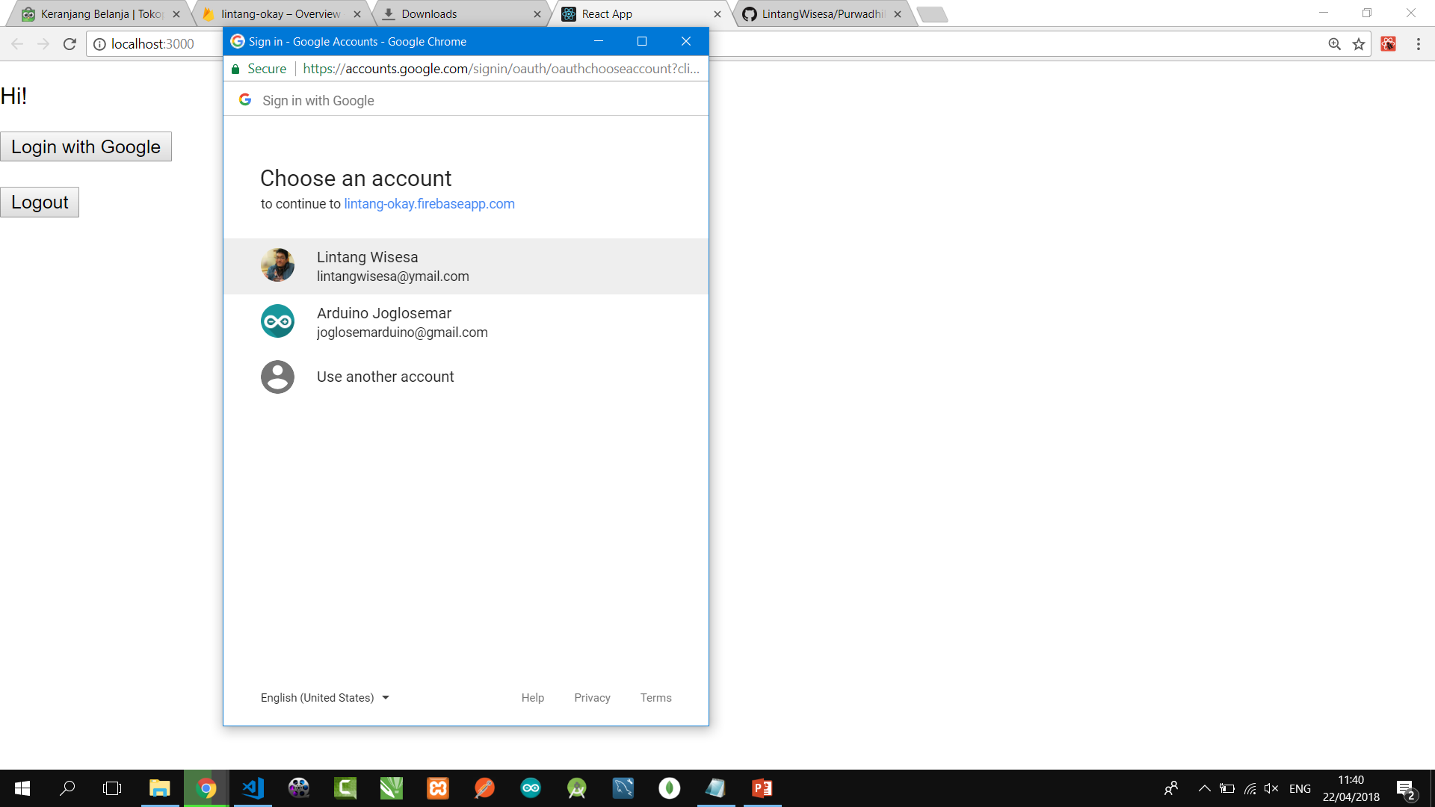
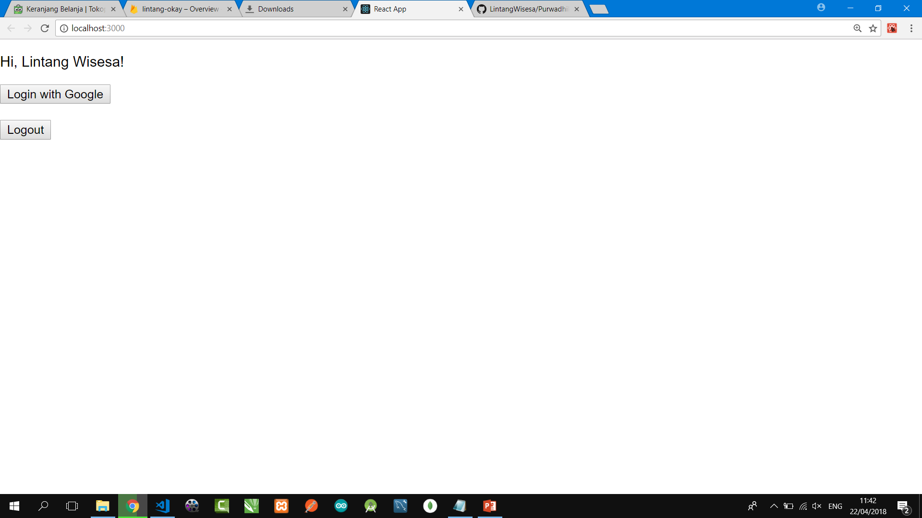
React, Firebase Auth
With Google Provider

Slide 11
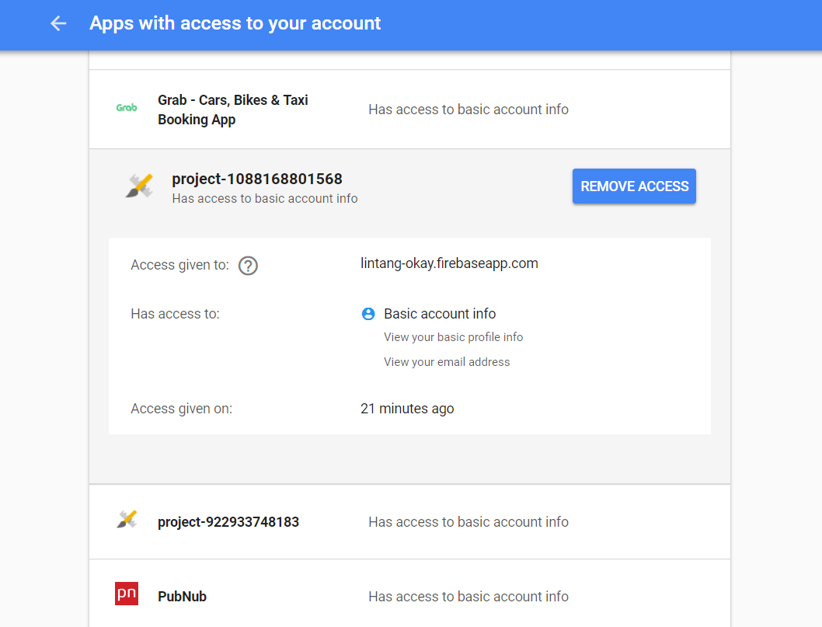
Revoke Google Permission
Go to https://myaccount.google.com/permissions then simply remove its access.

Slide 12

How to Setup React and
Firebase Authentication
with Facebook Provider?

Slide 13
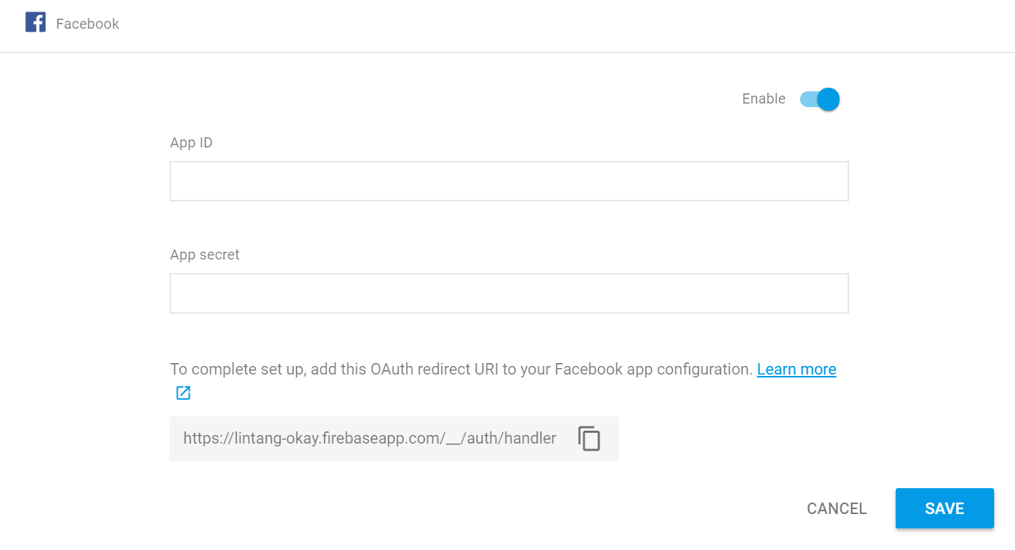
#1 Setup Firebase Auth
Login to Firebase Console, choose/create a project then go to Firebase Authentication. On Sign-In Method tab, enable Facebook sign-in provider!

Slide 14
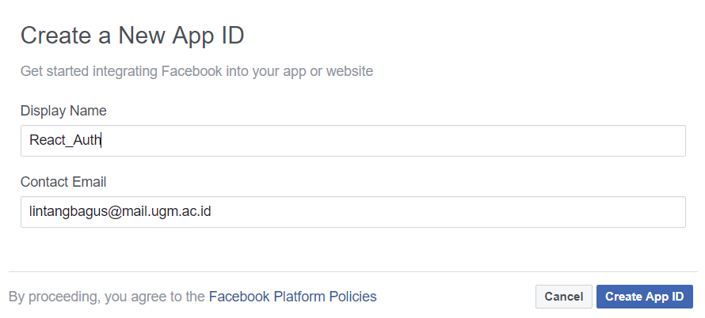
#2 Facebook Dev
Login to Facebook, then go to Facebook Dev at https://developers.facebook.com. Click on My Apps → Add a new App, insert Display Name & Contact Email then click Create App ID.

Slide 15
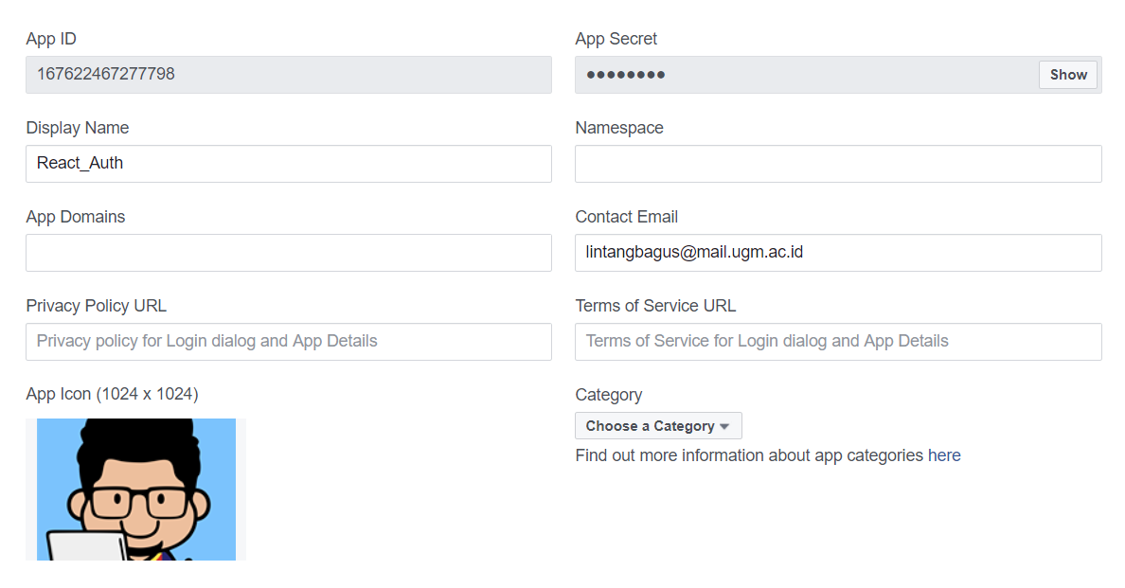
#3 App ID & Secret
On your Facebook dev dashboard, go to Settings menu → Basic, you will see your App ID & App Secret. Save its configuration!

Slide 16
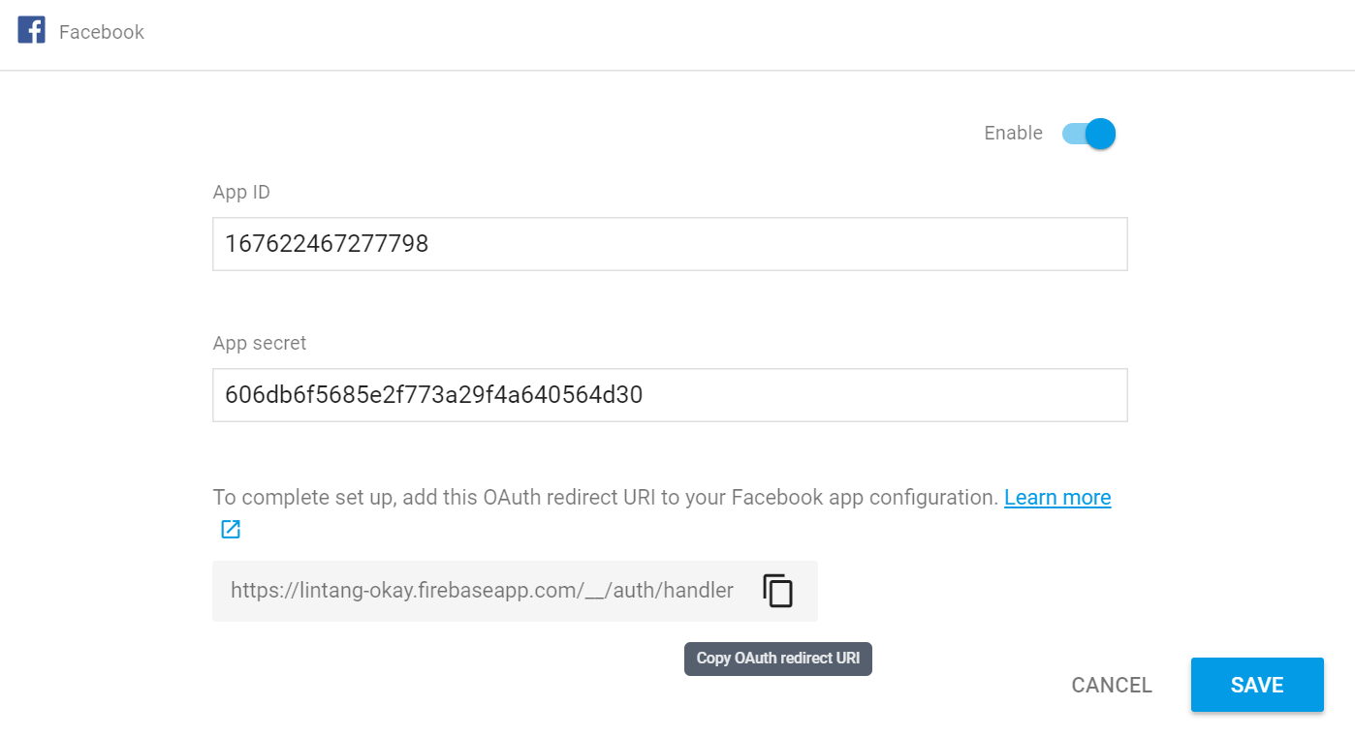
#4 Finishing Firebase Auth
Go back to Firebase Auth, insert our App ID & App Secret on Facebook sign-in provider. Then copy OAuth redirect URI. We’ll need this on Facebook dev.

Slide 17
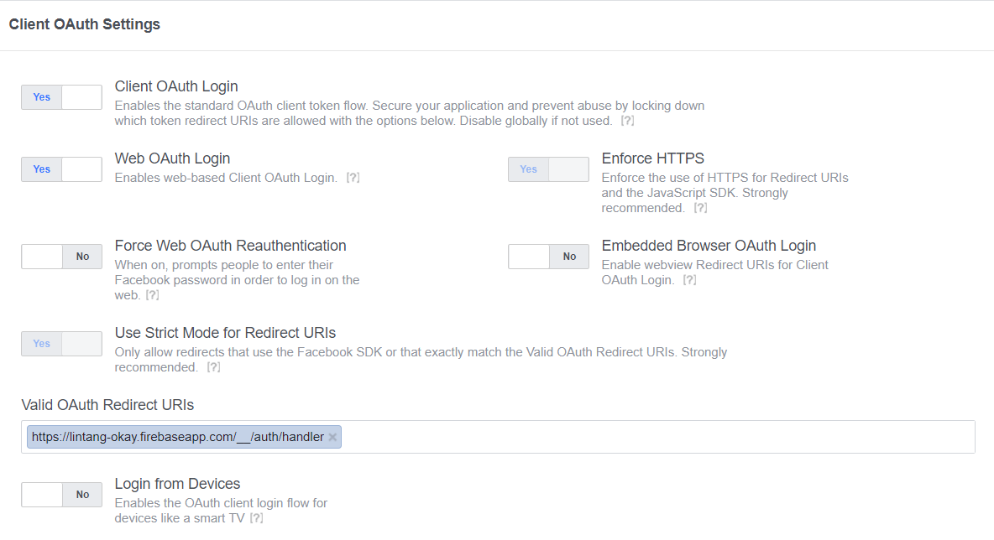
#5 Facebook Login
Go back to Facebook dev, Add a Product, choose Facebook Login. On its Settings, insert our OAuth redirect URI from Firebase. Save & you’re done.

Slide 18
#6 Firebase Snippet
Go to Firebase Project Overview, choose Add Firebase to Your Web App then copy its snippet code.

Slide 19
#7 Create/Prepare Your React App
Install create-react-app utility globally on your PC (if you have not done yet before)
$ npm install -g create-react-app
Create a new react app or prepare yours
$ create-react-app lin_auth
$ cd lin_auth
Install Firebase packages needed
$ npm install -g firebase-tools
$ npm install firebase

Slide 20
src/fire.js
#8 Insert Snippet
Create src/fire.js
import firebase from 'firebase';
var config = {
apiKey: "a1b2c3d4e5f6g7h8i9j0",
authDomain: "lintang-auth.firebaseapp.com",
databaseURL: "https://lintang-auth.firebaseio.com",
projectId: "lintang-auth",
storageBucket: "lintang-auth.appspot.com",
messagingSenderId: "1234567890"
};
firebase.initializeApp(config);
export const ref = firebase.database().ref();
export const auth = firebase.auth;
export const provider = new
firebase.auth.FacebookAuthProvider();

Slide 21
src/App.js
#9 Main Program
Part 1
import React, { Component } from 'react';
import { provider, auth } from './fire';
class App extends Component {
constructor(){
super();
this.state = {user: null}
}
async login() {
const result = await auth().signInWithPopup(provider);
this.setState({user: result.user});
}
async logout(){
await auth().signOut()
this.setState({user: null});
}
. . . . . .

Slide 22
src/App.js
#9 Main Program
Part 2
. . . . . .
render() {
return (
<div>
<p>
{this.state.user ? `Hi,
${this.state.user.displayName}!` : 'Hi!'}
</p>
<button onClick={this.login.bind(this)}>
Login with Facebook
</button>
<button onClick={this.logout.bind(this)}>
Logout
</button>
</div>
);}}
export default App;

Slide 23
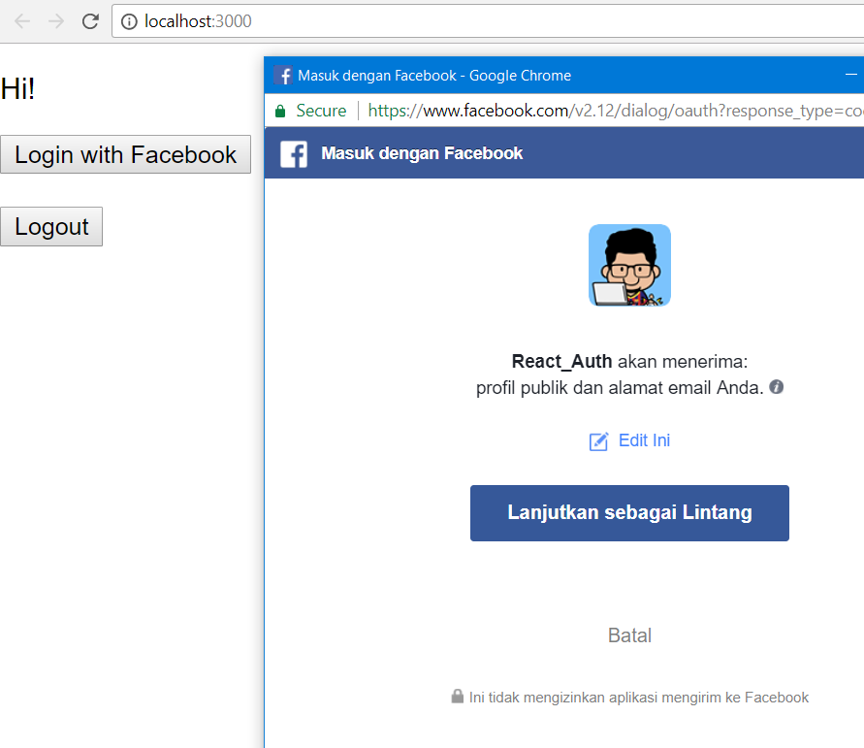
React, Firebase Auth
With Facebook Provider

Slide 24
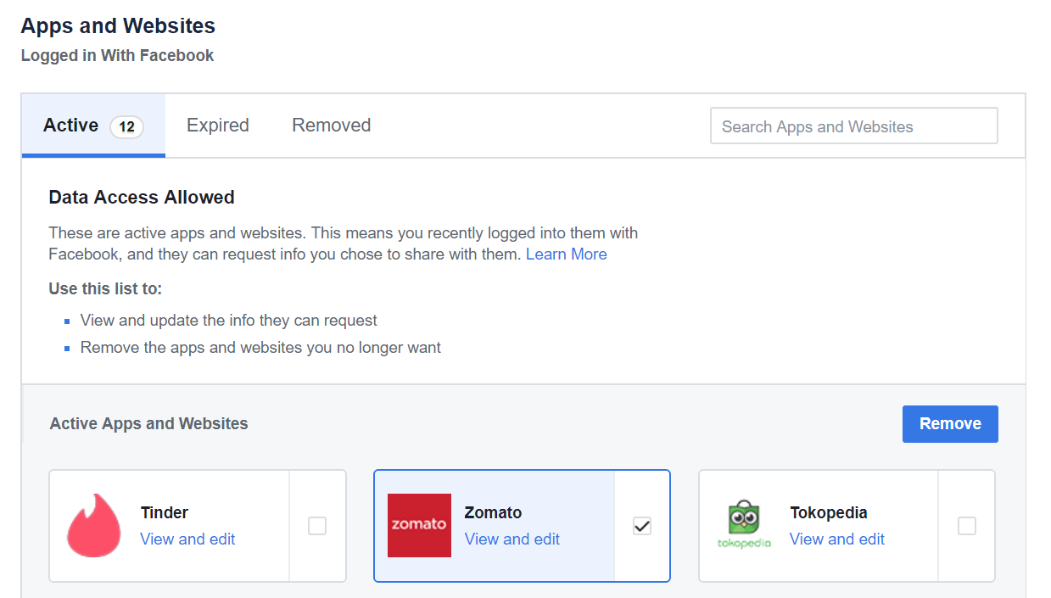
Revoke Facebook Permission
Go to Facebook.com, on Settings → Apps & Websites, tick on our app then simply remove it.

Slide 25
How to Setup React and
Firebase Authentication
with Twitter Provider?

Slide 26
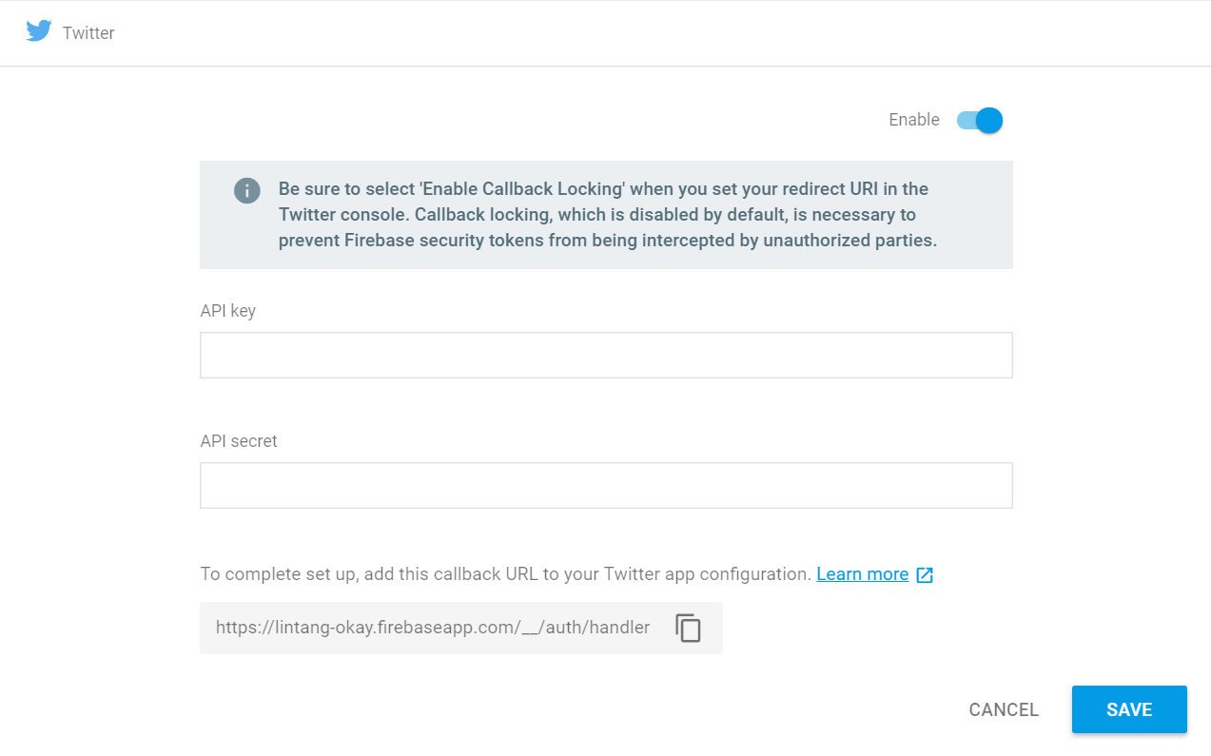
#1 Setup Firebase Auth
Login to Firebase Console, choose/create a project then go to Firebase Authentication. On Sign-In Method tab, enable Twitter sign-in provider & copy its Callback URL!

Slide 27
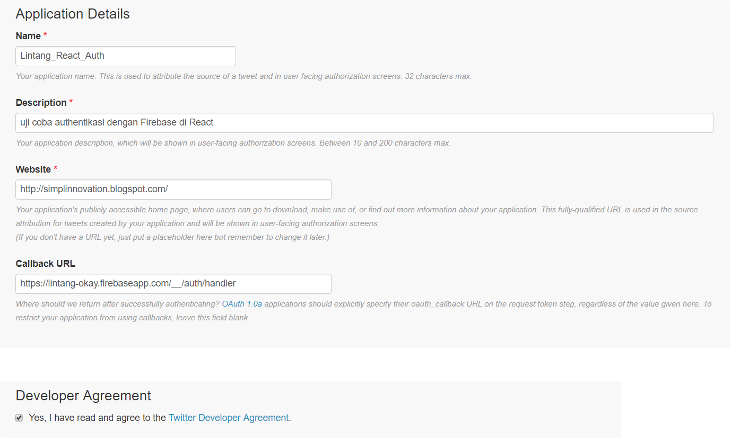
#2 Twitter Dev
Login to Twitter, go to https://dev.twitter.com/apps/new or https://apps.twitter.com/ and Create New App. Fill in the forms, insert our Callback URL then click Create Your Twitter Application.

Slide 28
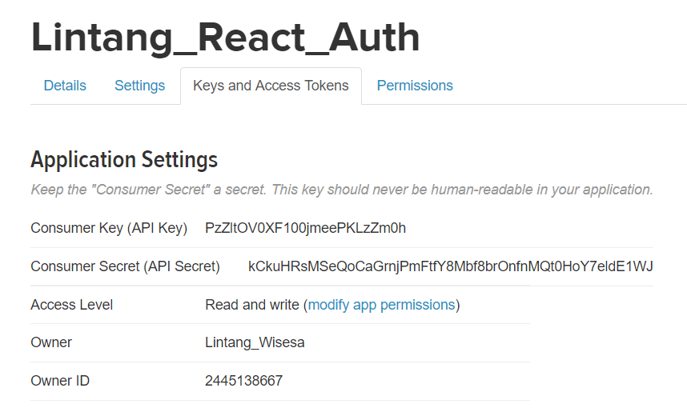
#3 API Key & Secret
Go to Keys and Access Tokens to get our API Key & API Secret. Copy these code to our Firebase Auth & Save!

Slide 29
#4 Firebase Snippet
Go to Firebase Project Overview, choose Add Firebase to Your Web App then copy its snippet code.

Slide 30
#5 Create/Prepare Your React App
Install create-react-app utility globally on your PC (if you have not done yet before)
$ npm install -g create-react-app
Create a new react app or prepare yours
$ create-react-app lin_auth
$ cd lin_auth
Install Firebase packages needed
$ npm install -g firebase-tools
$ npm install firebase

Slide 31
src/fire.js
#6 Insert Snippet
Create src/fire.js
import firebase from 'firebase';
var config = {
apiKey: "a1b2c3d4e5f6g7h8i9j0",
authDomain: "lintang-auth.firebaseapp.com",
databaseURL: "https://lintang-auth.firebaseio.com",
projectId: "lintang-auth",
storageBucket: "lintang-auth.appspot.com",
messagingSenderId: "1234567890"
};
firebase.initializeApp(config);
export const ref = firebase.database().ref();
export const auth = firebase.auth;
export const provider = new
firebase.auth.TwitterAuthProvider();

Slide 32
src/App.js
#7 Main Program
Part 1
import React, { Component } from 'react';
import { provider, auth } from './fire';
class App extends Component {
constructor(){
super();
this.state = {user: null}
}
async login() {
const result = await auth().signInWithPopup(provider);
this.setState({user: result.user});
}
async logout(){
await auth().signOut()
this.setState({user: null});
}
. . . . . .

Slide 33
src/App.js
#7 Main Program
Part 2
. . . . . .
render() {
return (
<div>
<p>
{this.state.user ? `Hi,
${this.state.user.displayName}!` : 'Hi!'}
</p>
<button onClick={this.login.bind(this)}>
Login with Twitter
</button>
<button onClick={this.logout.bind(this)}>
Logout
</button>
</div>
);}}
export default App;

Slide 34
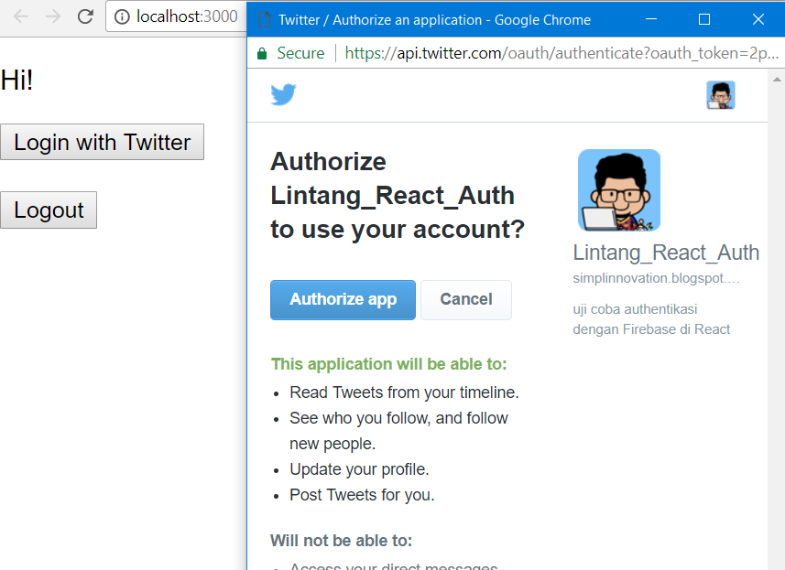
React, Firebase Auth
With Twitter Provider

Slide 35
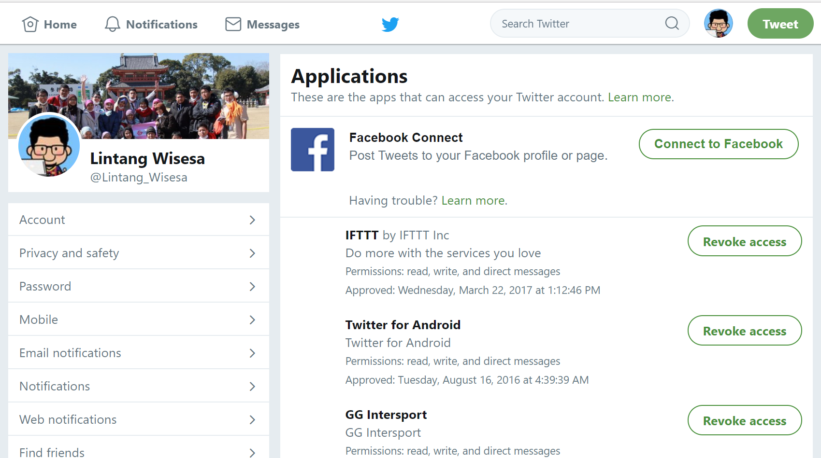
Revoke Twitter Permission
Go to Twitter.com, on Settings → Apps simply remove its access on an application.

Slide 36
React & Firebase
#3 Firebase Auth with Various Providers

